Slide 1

Reinforcement Learning
Reference:
David Silver’s slides, CS234 Reinforcement Learning
https://github.com/zhoubolei/introRL https://www.cnblogs.com/pinard/category/1254674.html

Slide 2
Lecture 1: Introduction to Reinforcement learning
Lecture 2: Markov Decision Process
Lecture 3: Model-free Reinforcement Learning
Lecture 4: Function Approximation and DQN
Lecture 5: Policy-based Reinforcement Learning
Lecture 6: Model-based Reinforcement Learning
Lecture 7: AlphaGo Zero

Slide 3
Lecture 1: Introduction to Reinforcement learning

Slide 4





强化学习的定义
a computational approach to learning whereby an agent tries to maximize the total amount of reward it receives while interacting with a complex and uncertain environment. ---Sutton and Barto
通过从交互学习来实现目标的计算方法 (Learning from interactions with environment)
智能体
(agent)
观察/状态
(observation/state)
行动
(action)
$$O_{t}/S_{t}$$
$$A_{t}$$
奖励
(reward)
$$R_{t+1}$$

Slide 5
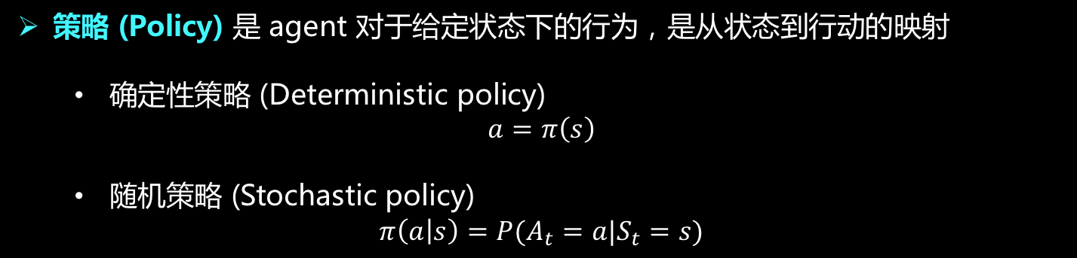
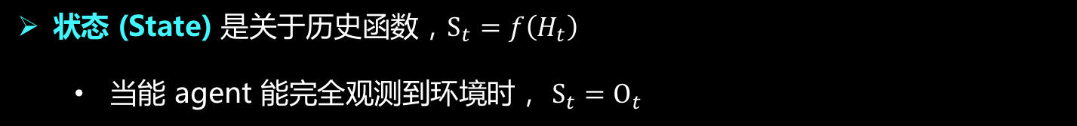
强化学习基本要素
历史 (History) 是观察、行动和奖励的序列，$H_{t}=O_{1},R_{1},A_{1},{ O}_{2},R_{2},A_{2},…,{ O}_{t}, R_{t}$
状态 (State) 是关于历史函数，$S_{t}=f\left(H_{t}\right)$
当能 agent 能完全观测到环境时， $S_{t}=O_{t}$
策略 (Policy) 是 agent 对于给定状态下的行为，是从状态到行动的映射
确定性策略 (Deterministic policy)
$$a=π\left(s\right)$$
随机策略 (Stochastic policy)
$$π\left(a | s\right)=P(A_{t}=a|S_{t}=s)$$

Slide 6
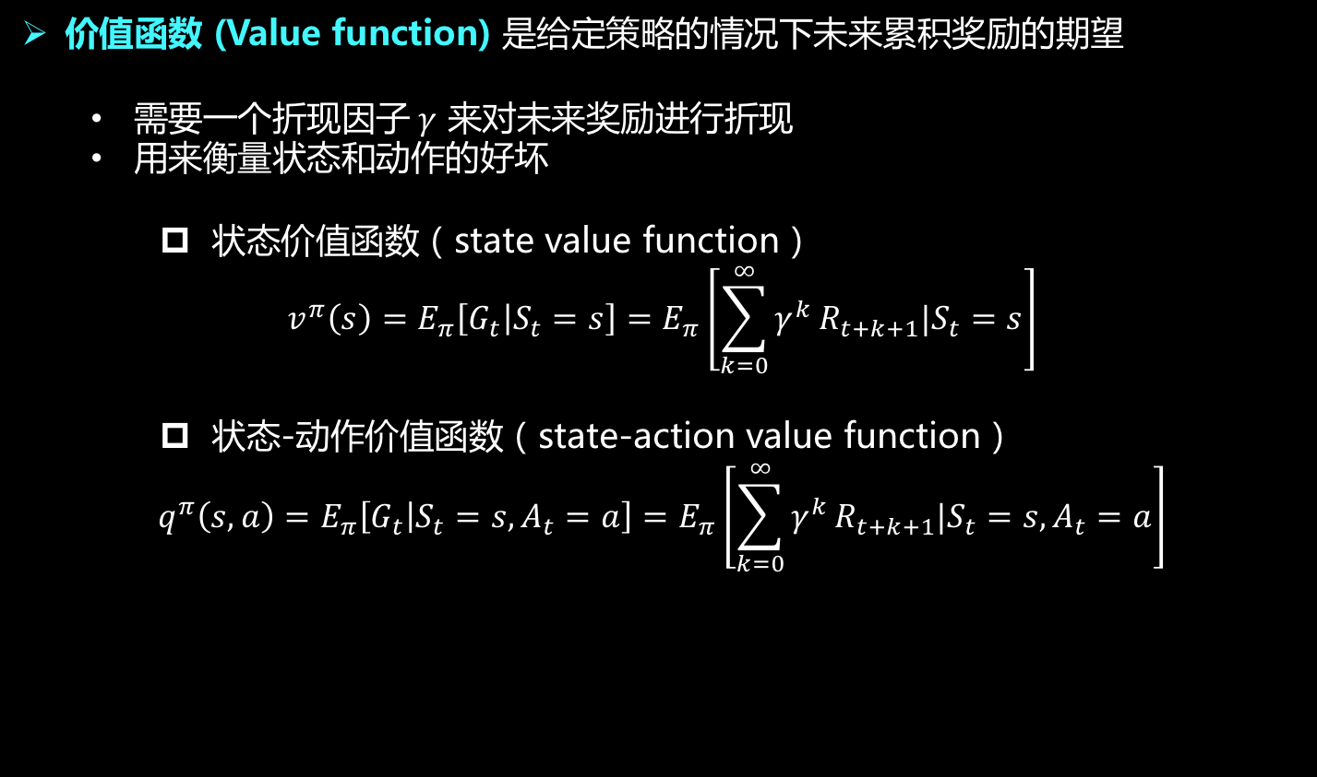
强化学习基本要素
奖励 (Reward) 是一个标量，用来评价 agent 在 step t 动作的好坏
可能即时的，也可能会有延迟（比如下围棋）
agent 的目标是要最大化累计奖励的期望
价值函数 (Value function) 是给定策略的情况下未来累积奖励的期望
需要一个折现因子$γ$ 来对未来奖励进行折现
用来衡量状态和动作的好坏
状态价值函数（state value function）
$$v^{π}\left(s\right)=E_{π}\left[G_{t} | S_{t}=s\right]=E_{π}\left[\sum_{k=0}^{∞}{γ^{k}}R_{t+k+1}|S_{t}=s\right]$$
状态-动作价值函数（state-action value function）
$$q^{π}\left(s,a\right)=E_{π}\left[G_{t} | S_{t}=s,A_{t}=a\right]=E_{π}\left[\sum_{k=0}^{∞}{γ^{k}}R_{t+k+1}|S_{t}=s,A_{t}=a\right]$$

Slide 7
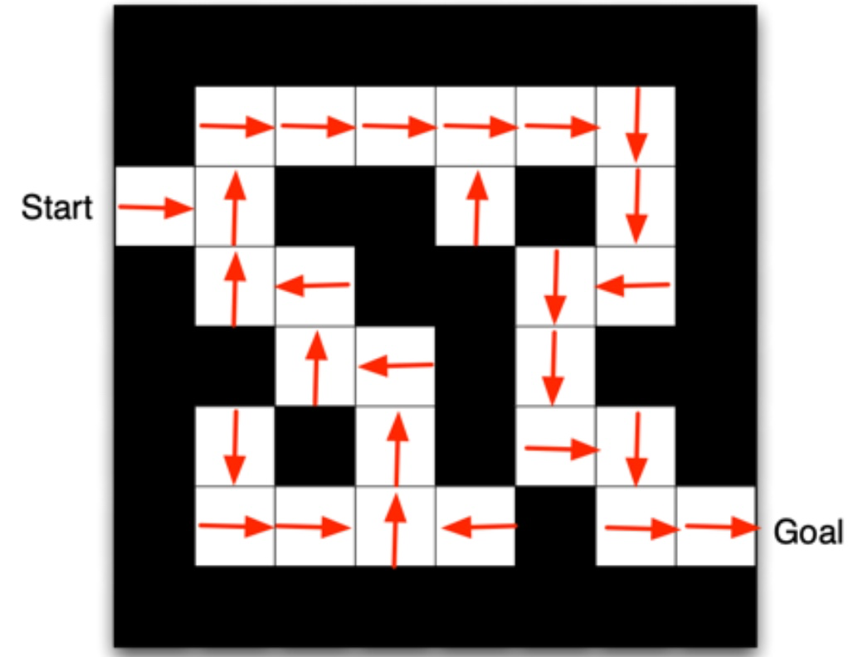
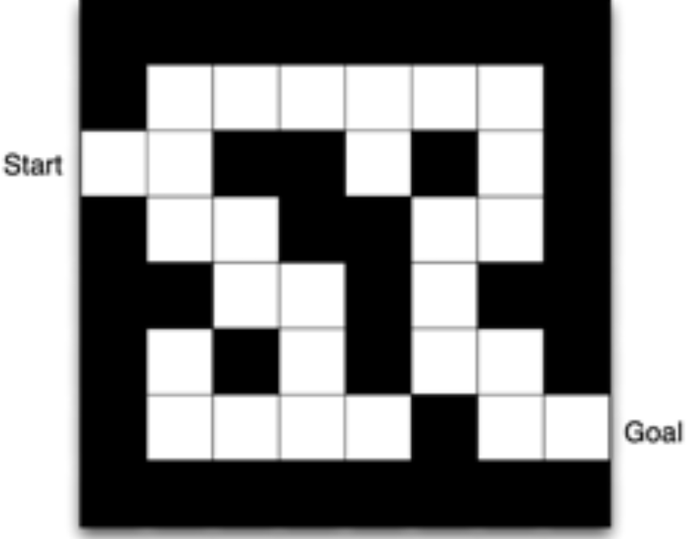



强化学习基本要素
环境的模型 (Model) 用于模拟环境的行为
预测下一个状态
$$P_{ss′}^{a}=P(S_{t+1}=s^{′}|S_{t}=s, A_{t}=a)$$
预测下一个奖励
$$R_{s}^{a}=P(R_{t+1}|S_{t}=s, A_{t}=a)$$
Maze Example
状态：agent的位置
行动：N，E，S，W
奖励：每一步 -1
箭头表示每个状态的策略$π(s)$
方格中的值表示$v^{π}(s)$

Slide 8
强化学习的分类
是否有环境模型
Agent 学习的内容
基于模型 (mode-based) 的强化学习
有环境模型
模型无关 (mode-free) 的强化学习
没有环境模型
基于价值 (value-based) 的强化学习
学习价值函数
没有策略（隐含）
基于策略 (policy-based) 的强化学习
学习策略
没有价值函数
Actor-Critic 的强化学习
学习价值函数
学习策略

Slide 9
监督学习、无监督学习和强化学习
预测
监督学习：根据数据预测所需输出
数据独立同分布
有正确的标签
监督学习
无监督学习
无监督学习：生成数据实例
机器学习
数据独立同分布
只有数据的特征，无标签
决策
强化学习：在动态环境中采取行动
强化学习
数据是时序相关的，不 i.i.d
没有正确的标签，只有每一步的 reward

Slide 10
Lecture 2: Markov Decision Process

Slide 11
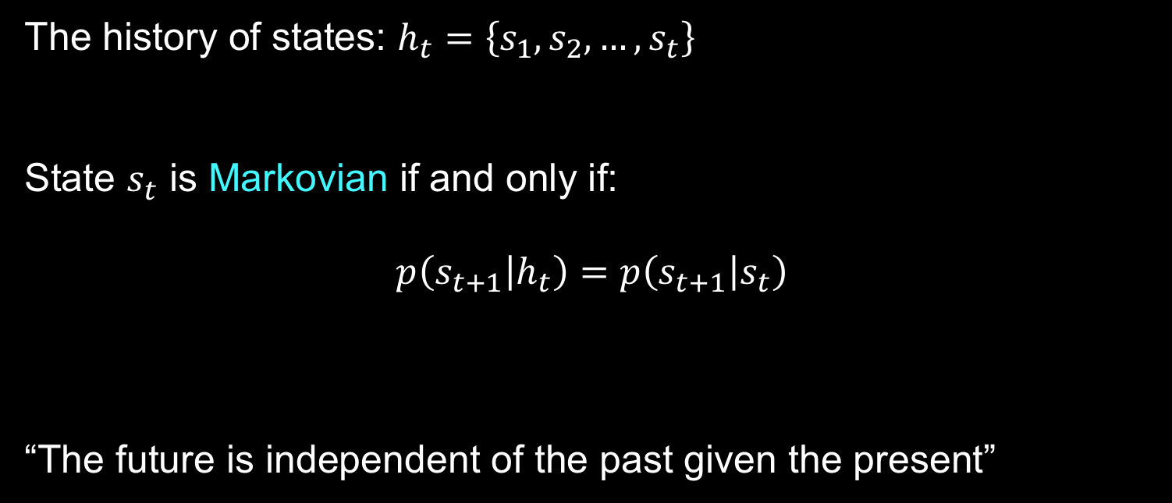
Markov Property
The history of states: $h_{t}=\left\{s_{1},s_{2},…,s_{t}\right\}$
State $s_{t}$ is Markovian if and only if:
$$p\left(s_{t+1} | h_{t}\right)=p\left(s_{t+1} | s_{t}\right)$$
“The future is independent of the past given the present”

Slide 12

Definition of MDP
MDP can be represented as a tuple: ($S,A,P,R,γ$)
$S$ is a set of states
$A$ is a set of actions
$P$ is transition model: $P(s_{t+1}=s^{′}|s_{t}=s, A_{t}=a)$
$R$ is reward function $R\left(s,a\right)=E\left[r_{t+1} | S_{t}=s,A_{t}=a\right]$
$γ$ is discount factor $γ∈[0,1]$

Slide 13

Value function for MDP
状态价值函数（state value function）
$$v^{π}\left(s\right)=E_{π}\left[G_{t} | S_{t}=s\right]=E_{π}\left[R_{t+1}+γR_{t+2}+γ^{2}R_{t+3}+…|S_{t}=s\right]$$
状态-动作价值函数（state-action value function）
$$q^{π}\left(s,a\right)=E_{π}\left[G_{t} | S_{t}=s,A_{t}=a\right]=E_{π}\left[R_{t+1}+γR_{t+2}+γ^{2}R_{t+3}+…|S_{t}=s,A_{t}=a\right]$$
Relation between $v^{π}\left(s\right)$ and${ q}^{π}\left(s,a\right)$
$$v^{π}\left(s\right)=\sum_{a∈A}{{π(a|s)q}^{π}\left(s,a\right)}$$
$$q^{π}\left(s,a\right)=R\left(s,a\right)+γ\sum_{s^{′}∈S}{P\left(s^{′} | s,a\right)v^{π}(s^{′})}$$

Slide 14
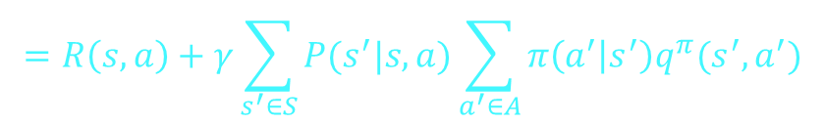
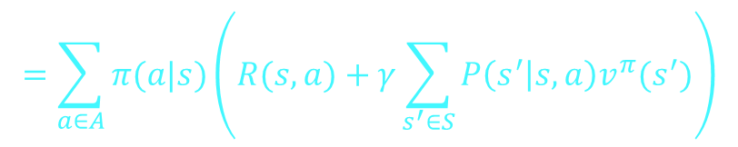


Bellman Expectation Equation
$$v^{π}\left(s\right)=E_{π}\left[G_{t} | S_{t}=s\right]=E_{π}\left[R_{t+1}+γR_{t+2}+γ^{2}R_{t+3}+…|S_{t}=s\right]$$
$$=E_{π}\left[R_{t+1}+γG_{t+1}|S_{t}=s\right]$$
$$=E_{π}[R_{t+1}+γv^{π}(S_{t+1})|S_{t}=s]$$
$$=\sum_{a∈A}{π(a|s)\left(R(s,a)+γ\sum_{s^{′}∈S}{P\left(s^{′} | s,a\right)v^{π}(s^{′})}\right)}$$
The action-value function can similarly be decomposed
$$q^{π}\left(s,a\right)=E_{π}[R_{t+1}+γq^{π}\left(S_{t+1},A_{t+1}\right)|S_{t}=s, A_{t}=a]$$
$$=R\left(s,a\right)+γ\sum_{s^{′}∈S}{P(s^{′}|s,a)\sum_{a^{′}∈A}{π\left(a^{′} | s^{′}\right)q^{π}(s^{′},a^{′})}}$$

Slide 15


Decision Making in MDP
Prediction
evaluate a given policy
Input a MDP and a policy $π$, output value function $v^{π}(s)$
Control
search for the optimal policy
Input a MDP, output optimal value function $v^{∗}$ and optimal policy $π^{∗}$

Slide 16
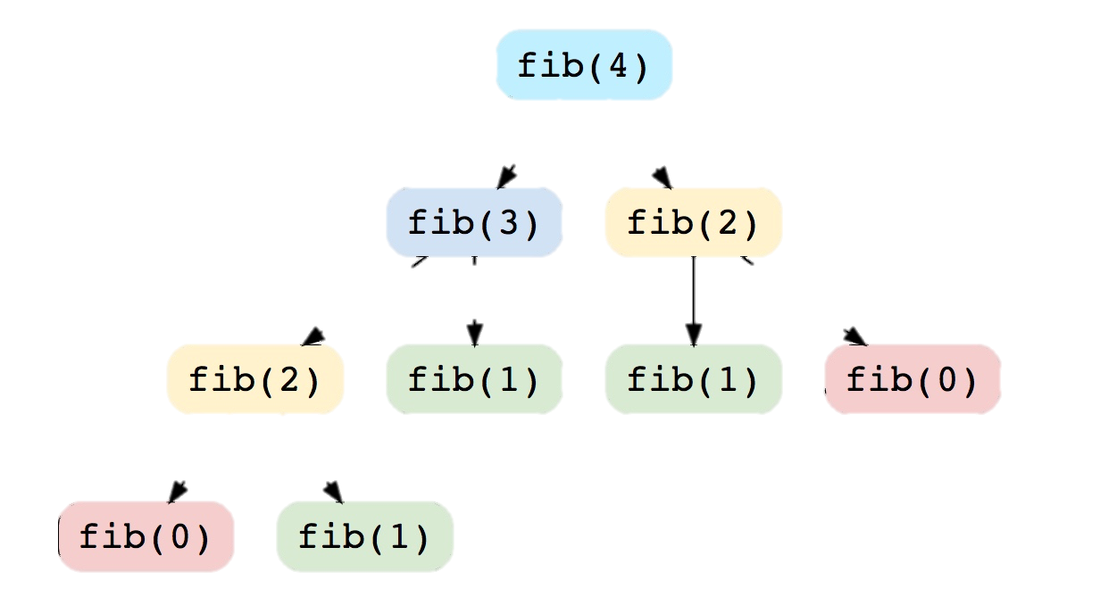
Dynamic Programming
Characteristics of DP
overlapping subproblems
finding the solution involves solving the same subproblem multiple times
optimal substructure property
the overall optimal solution can be constructed from the optimal solutions of its subproblems
MDP satisfies both properties

Slide 17
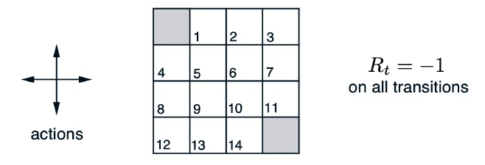
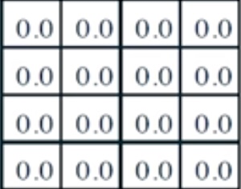
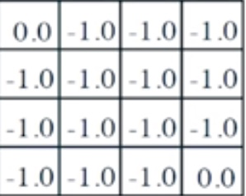
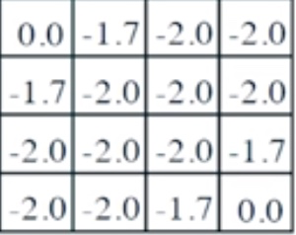
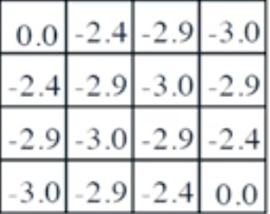
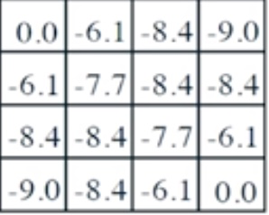
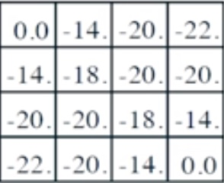



Policy evaluation in MDP
Evaluating a Random Policy in the Small Gridworld
Iteration on Bellman expectation backup
$$v_{t+1}\left(s\right)=\sum_{a∈A}{π(a|s)\left(R(s,a)+γ\sum_{s^{′}∈S}{P\left(s^{′} | s,a\right)v_{t} (s^{′})}\right)}$$
Convergence: $v_{1}→v_{2}→…→v^{π}$
Transition is deterministic given the action
Two terminal states (two shaded squares)
t=0
t=1
t=2
t=3
t=10
t=$∞$

Slide 18

Find Optimal Policy
The optimal value function
$$v^{∗}\left(s\right)=\max_{π}{v^{π}(s)}$$
The optimal policy
$${\text{π}}^{\text{∗}}\left(\text{s}\right)\text{=}\arg{\max_{π}{v^{π}(s)}}$$
An optimal policy can be found by maximizing over $q^{∗}\left(s,a\right)$
$$π^{∗}\left(a | s\right)=f\left(x\right)=\left\{\begin{aligned}1, if a=\arg{\max_{a∈A}{q^{∗}(s,a)}} \\ 0, otherwise\end{aligned}\right.$$
Noting that $q^{∗}\left(s,a\right)=R\left(s,a\right)+γ\sum_{s^{′}∈S}{P\left(s^{′} | s,a\right)v^{∗}(s^{′})}$

Slide 19

Policy Iteration for MDP Control
Iterate between the two steps:
Evaluate the policy $π$ (compute v given current $π)$
Improve policy $π$ by acting greedily with respect to $v^{π}$
$q^{π_{t}}\left(s,a\right)=R\left(s,a\right)+γ\sum_{s^{′}∈S}{P\left(s^{′} | s,a\right)v^{π_{t}}(s^{′})}$
$π_{t+1}\left(s\right)=\arg{\max_{a}{q^{π_{t}}\left(s,a\right)}}$

Slide 20
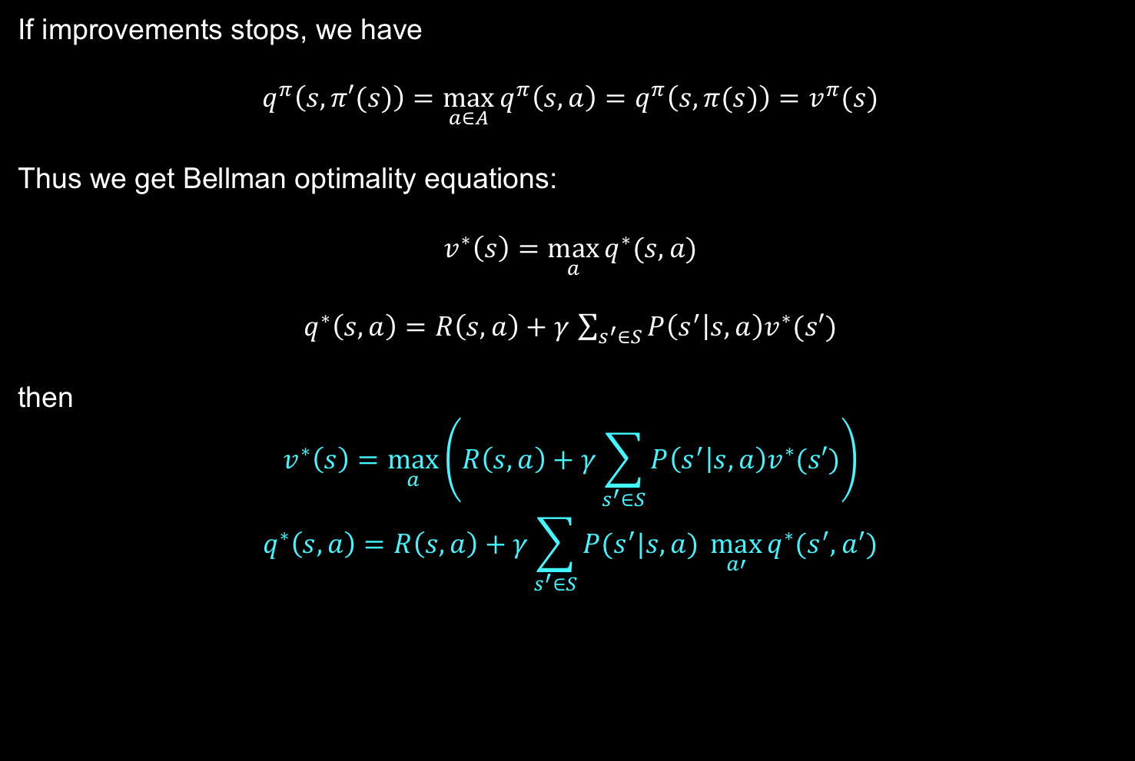
Bellman Optimality Equation
If improvements stops, we have
$$q^{π}\left(s,π′(s)\right)=\max_{a∈A}{q^{π}\left(s,a\right)=q^{π}\left(s,π(s)\right)=v^{π}(s)}$$
Thus we get Bellman optimality equations:
$$v^{∗}\left(s\right)=\max_{a}{q^{∗}(s,a)}$$
$q^{∗}\left(s,a\right)=R\left(s,a\right)+γ$ $\sum_{s^{′}∈S}{P\left(s^{′} | s,a\right)v^{∗}(s′)}$
then
$$v^{∗}\left(s\right)=\max_{a}\left(R\left(s,a\right)+γ\sum_{s^{′}∈S}{P\left(s^{′} | s,a\right)v^{∗}(s′)}\right)$$
$$q^{∗}\left(s,a\right)=R\left(s,a\right)+γ\sum_{s^{′}∈S}{P(s^{′}|s,a) \max_{a′}{q^{∗}(s^{′},a^{′})}}$$
Used for Value Iteration

Slide 21

Value Iteration for MDP Control
Iteration on the Bellman optimality backup
$$v\left(s\right)←\max_{a∈A}\left(R\left(s,a\right)+γ \sum_{s^{′}∈S}{P\left(s^{′} | s,a\right)v (s′)}\right)$$
Algorithm:
1. Initialize k=1 and $v_{0}\left(s\right)=0$ for all states s
2. For k=1:K
1. For each state s
$$q_{k+1}\left(s,a\right)=R\left(s,a\right)+γ \sum_{s^{′}∈S}{P\left(s^{′} | s,a\right)v_{k} (s′)}$$
$$v_{k+1}\left(s\right)=\max_{a}{q_{k+1}(s,a)}$$
2. k = k+1
3. To retrieve the optimal policy after the value iteration
$$π\left(s\right)=\arg{\max_{a∈A}\left(R\left(s,a\right)+γ \sum_{s^{′}∈S}{P\left(s^{′} | s,a\right)v_{k+1} (s′)}\right)}$$

Slide 22

Comparison between PI and VI
Policy Iteration
Value Iteration
policy evaluation + policy improvement
finding optimal value function + one policy extraction
can also be seen as
truncated policy evaluation (reassigning $v\left(s\right)$ after just one step)
policy improvement (max operation)

Slide 23
Lecture 3: Model-free Reinforcement Learning

Slide 24

Learning by Interaction
In many real world problems, we may not know the MDP model or it is just too big to use
Games
Robot control
Helicopter
Portfolio management
Model-free RL can solve the problems by letting the agent interact with the environment and collecting trajectories/episodes:
$$\left\{S_{1},A_{1},R_{1}, S_{2},A_{2},R_{2},…,S_{T},A_{T},R_{T}\right\}$$
Two methods:
1. Monte Carlo method
2. Temporal Difference (TD) learning

Slide 25
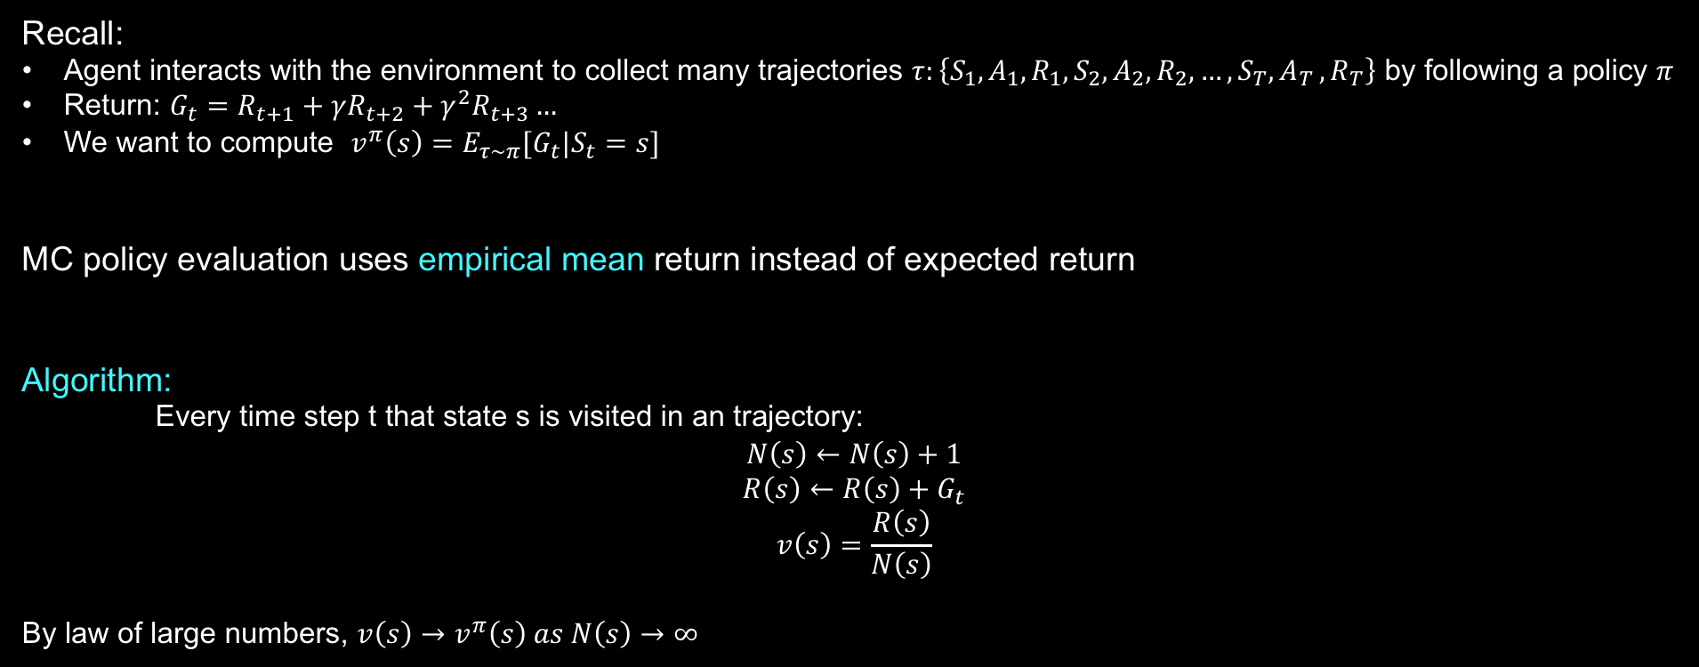
Monte Carlo Policy Evaluation
Recall:
Agent interacts with the environment to collect many trajectories $τ:\left\{S_{1},A_{1},R_{1}, S_{2},A_{2},R_{2},…,S_{T}{,A}_{T},R_{T}\right\}$ by following a policy $π$
Return: $G_{t}=R_{t+1}+γR_{t+2}+γ^{2}R_{t+3}…$
We want to compute $v^{π}\left(s\right)=E_{τ∼π}[G_{t}|S_{t}=s]$
MC policy evaluation uses empirical mean return instead of expected return
Algorithm:
Every time step t that state s is visited in an trajectory:
$$N\left(s\right)←N\left(s\right)+1$$
$$R\left(s\right)←R\left(s\right)+G_{t}$$
$$v\left(s\right)=\frac{R\left(s\right)}{N\left(s\right)}$$
By law of large numbers, $v\left(s\right)→v^{π}\left(s\right) as N\left(s\right)→∞$

Slide 26
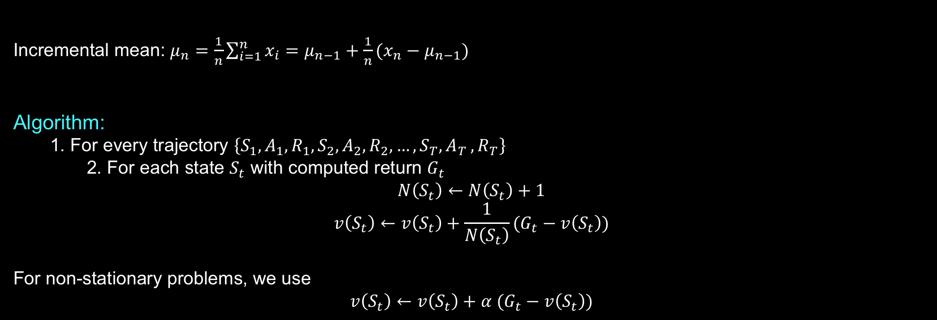
Incremental MC Update
Incremental mean: $μ_{n}=\frac{1}{n}\sum_{i=1}^{n}{x_{i}}=μ_{n−1}+\frac{1}{n}(x_{n}−μ_{n−1})$
Algorithm:
1. For every trajectory $\left\{S_{1},A_{1},R_{1}, S_{2},A_{2},R_{2},…,S_{T}{,A}_{T},R_{T}\right\}$
2. For each state $S_{t}$ with computed return $G_{t}$
$$N\left(S_{t}\right)←N\left(S_{t}\right)+1$$
$$v\left(S_{t}\right)←v\left(S_{t}\right)+\frac{1}{N\left(S_{t}\right)}(G_{t}−v\left(S_{t}\right))$$
For non-stationary problems, we use
$$v\left(S_{t}\right)←v\left(S_{t}\right)+α (G_{t}−v\left(S_{t}\right))$$
MC does not require MDP model, no bootstrapping, and even does not require the state is Markovian,
but it can only apply to trajectories that are complete and have terminal state.

Slide 27
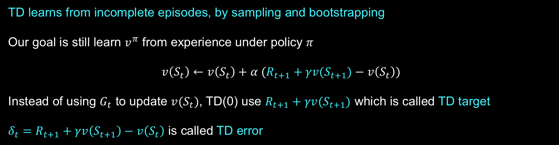


Temporal-Difference Learning
TD learns from incomplete episodes, by sampling and bootstrapping
Our goal is still learn $v^{π}$ from experience under policy $π$
$$v\left(S_{t}\right)←v\left(S_{t}\right)+α (R_{t+1}+γv(S_{t+1})−v\left(S_{t}\right))$$
Instead of using $G_{t}$ to update $v(S_{t})$, TD(0) use $R_{t+1}+γv(S_{t+1})$ which is called TD target
$δ_{t}=R_{t+1}+γv\left(S_{t+1}\right)−v\left(S_{t}\right)$ is called TD error
$$n=1\left(TD(0)\right) G_{t}^{\left(1\right)}=R_{t+1}+γv\left(S_{t+1}\right)$$
$$n=2 G_{t}^{\left(2\right)}=R_{t+1}+γR_{t+2}+γ^{2}v\left(S_{t+2}\right)$$
n-step TD prediction
$$⋮$$
$$n=∞\left(MC\right) G_{t}^{\left(∞\right)}=R_{t+1}+γR_{t+2}+…+γ^{T−t−1}R_{T}$$

Slide 28
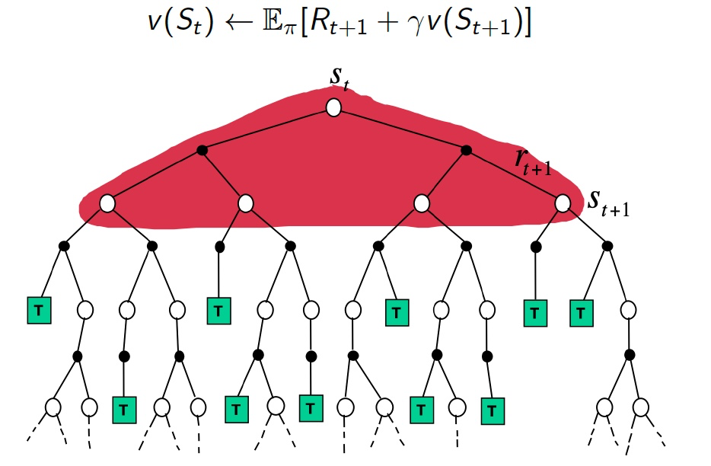
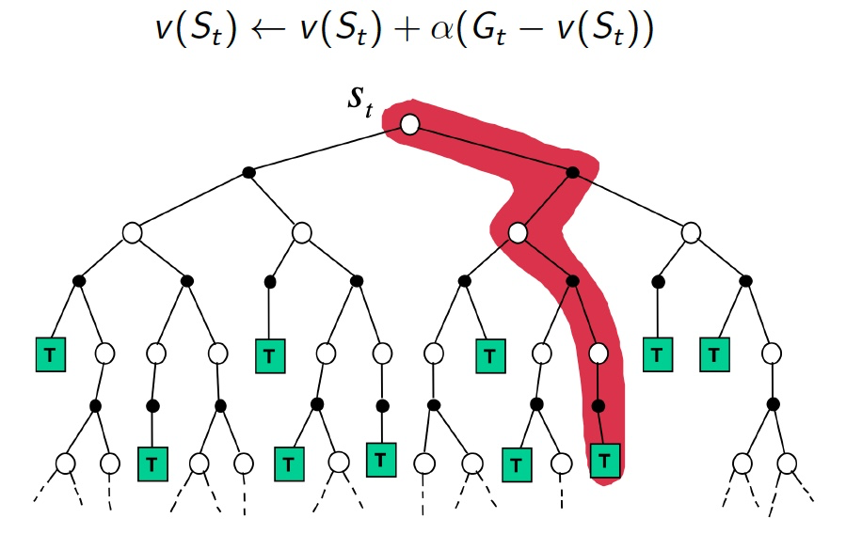
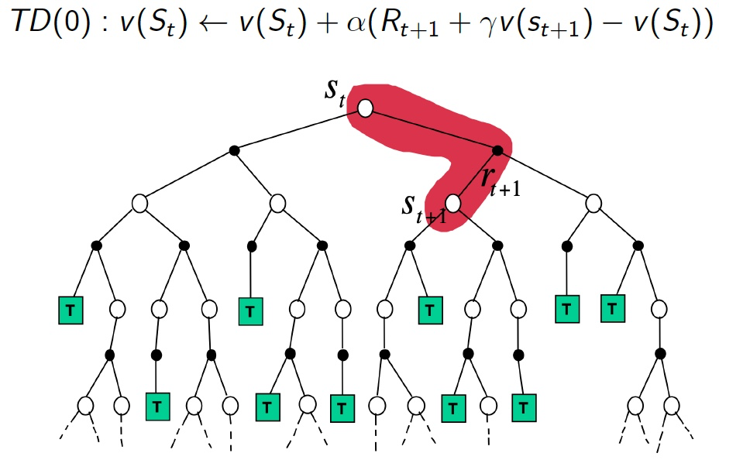
DP, MC and TD
Bootstrapping
Sampling
Update involves an estimate
DP bootstraps
MC does not bootstrap
TD bootstraps
Update samples an expectation
DP does not sample
MC samples
TD samples
Dynamic Programming
Monte Carlo
Temporal Difference Learning

Slide 29
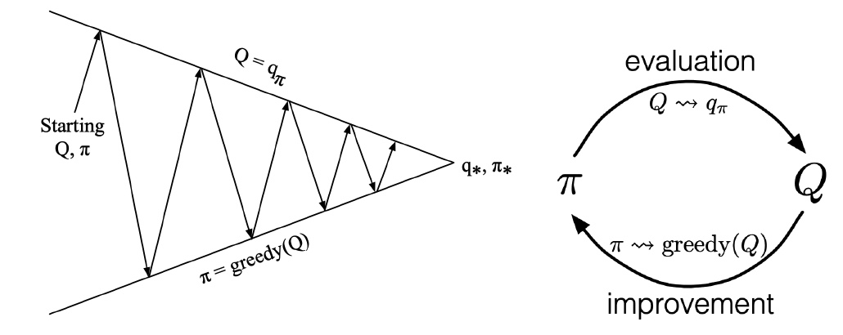
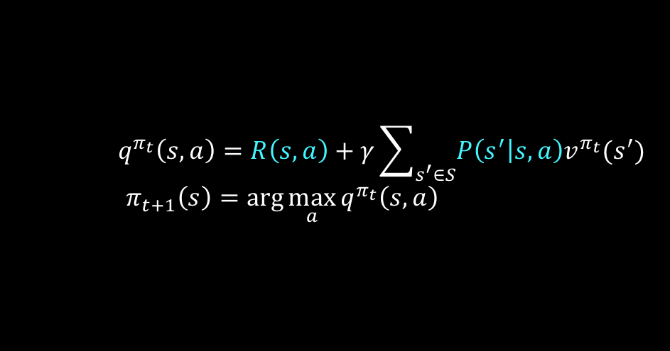
Model-free Control for MDP
Now we want to optimize the value function of a unknown MDP
Policy Iteration for a known MDP
use MC or TD
to do the policy evaluation
policy improvement is the same
$$q^{π_{t}}\left(s,a\right)=R\left(s,a\right)+γ\sum_{s^{′}∈S}{P\left(s^{′} | s,a\right)v^{π_{t}}(s^{′})}$$
$$π_{t+1}\left(s\right)=\arg{\max_{a}{q^{π_{t}}\left(s,a\right)}}$$
we don’t know

Slide 30
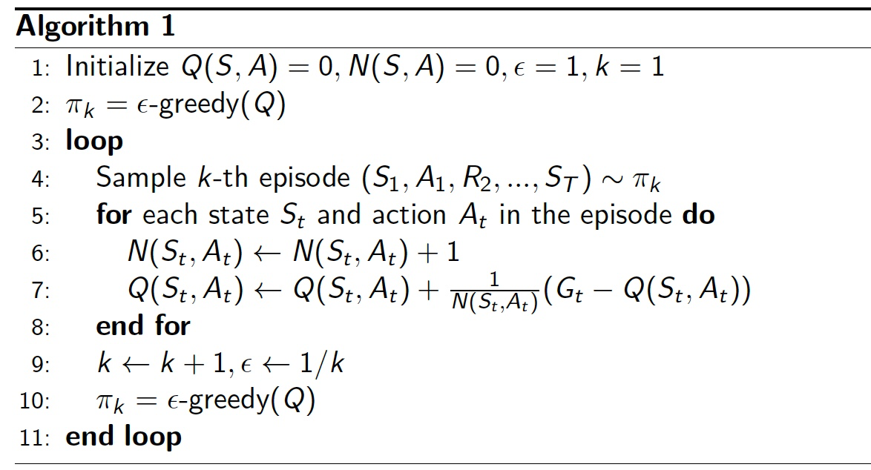


MC with $ε$–Greedy Exploration
we need to trade off between exploration and exploitation
$ε$–Greedy Exploration
$$π\left(a | s\right)=\left\{\begin{aligned}\frac{ε}{\left|A\right|}+1−ε, if a^{∗}=\arg{\max_{a∈A}{q\left(s, a\right)}}& \\ \frac{ε}{\left|A\right|}, otherwise\end{aligned}\right.$$

Slide 31
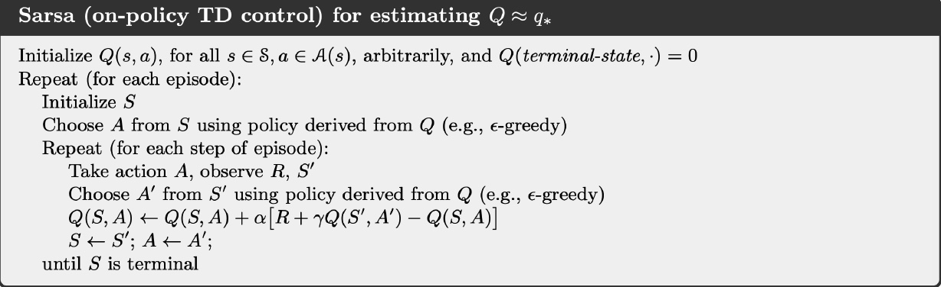


Sarsa: TD Control
The update is done after every transition, no need to wait until the trajectory is finished.
$ε$-greedy policy for one step to choose action $A′$, then bootstrap the action value function to do the update:
$$Q\left(S_{t},A_{t}\right)←Q\left(S_{t},A_{t}\right)+α\left[R_{t+1}+γQ(S_{t+1},A_{t+1})−Q\left(S_{t},A_{t}\right)\right]$$
we can also do n-step Sarsa

Slide 32
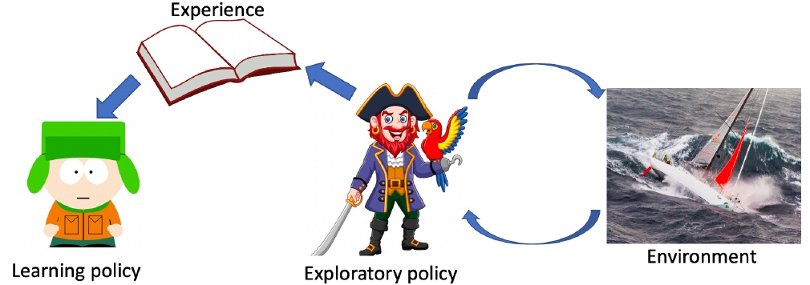

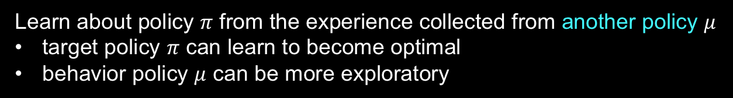
On-policy vs. Off-policy
On-policy learning
Learn about policy $π$ from the experience collected from $π$
Sarsa is on-policy learning
Off-policy learning
Learn about policy $π$ from the experience collected from another policy $μ$
target policy $π$ can learn to become optimal
behavior policy $μ$ can be more exploratory

Slide 33
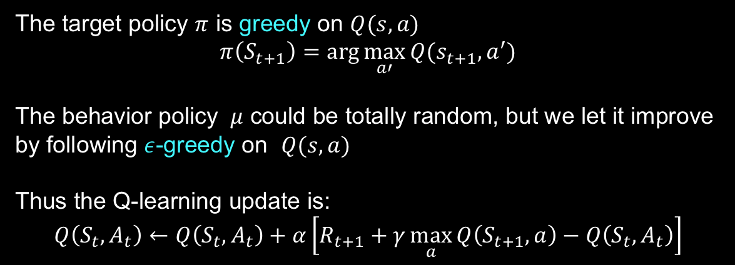

Q-learning: Off-policy Control
The target policy $π$ is greedy on $Q(s,a)$
$$π\left(S_{t+1}\right)=\arg{\max_{a′}{Q(s_{t+1},a^{′})}}$$
The behavior policy $μ$ could be totally random, but we let it improve by following $ε$-greedy on $Q(s,a)$
Thus the Q-learning update is:
$$Q\left(S_{t},A_{t}\right)←Q\left(S_{t},A_{t}\right)+α\left[R_{t+1}+γ\max_{a}{Q\left(S_{t+1},a\right)−Q\left(S_{t},A_{t}\right)}\right]$$
Sarsa still use $ε$-greedy on $Q(s,a)$ here

Slide 34
Lecture 4: Function Approximation and DQN

Slide 35

Function Approximation
Why do we need function approximation?
large-scale problems:
Chess: ${10}^{47}$ states
Game of Go: ${10}^{170}$ states
Robot Arm: continuous state and action space
How to do?
$$\hat{v}\left(s, θ\right)≈v^{π}\left(s\right)$$
$$\hat{q}\left(s,a,θ\right)≈q^{π}\left(s,a\right)$$
$$\hat{π}(s,θ)≈π(a|s)$$
Many possible function approximators:
Linear functions
Decision trees
Neural networks
generalization

Slide 36

State-Action Value Function Approximation
Approximate the state-action value function
$$\hat{Q}\left(s,a,θ\right)≈Q^{π}\left(s,a\right)$$
Minimize the MSE between the estimate and the true value (suppose we know)
$$J\left(θ\right)=E_{π}\left[{\frac{1}{2}\left(Q^{π}\left(s,a\right)−\hat{Q}\left(s,a,θ\right)\right)}^{2}\right]$$
Stochastic gradient descend
$$θ←θ−α∇_{θ}J\left(θ\right)=θ+α\left(Q^{π}\left(s,a\right)−\hat{Q}\left(s,a,θ\right)\right)∇_{θ}\hat{Q}\left(s,a,θ\right)$$

Slide 37
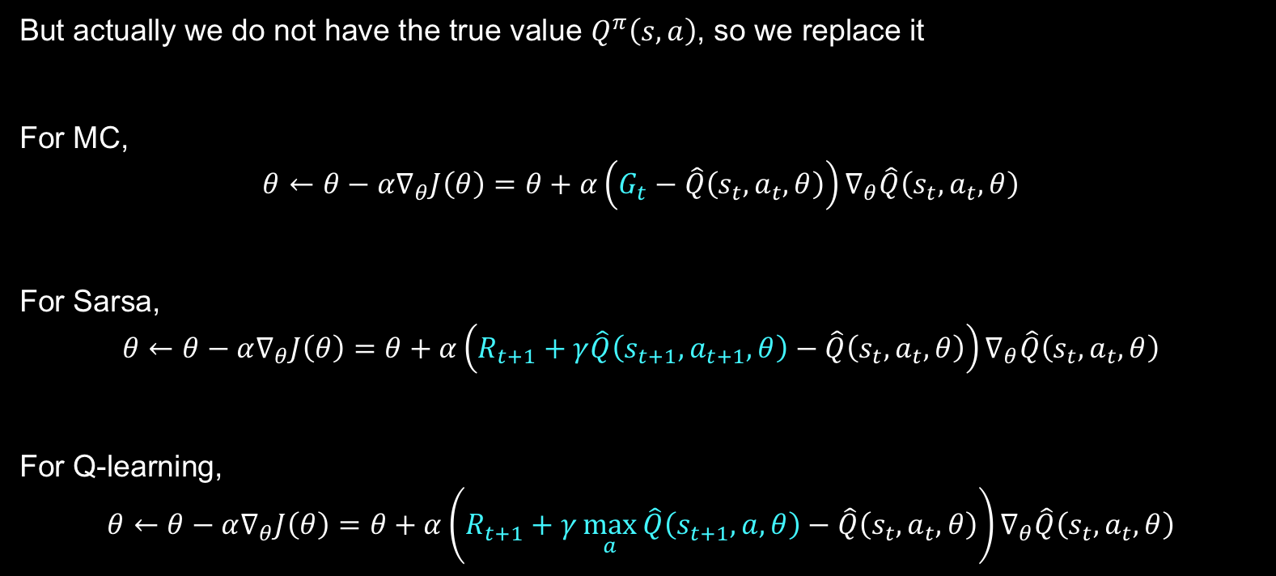
State-Action Value Function Approximation
But actually we do not have the true value $Q^{π}\left(s,a\right)$, so we replace it
For MC,
$$θ←θ−α∇_{θ}J\left(θ\right)=θ+α\left(G_{t}−\hat{Q}\left(s_{t},a_{t},θ\right)\right)∇_{θ}\hat{Q}\left(s_{t},a_{t},θ\right)$$
For Sarsa,
$$θ←θ−α∇_{θ}J\left(θ\right)=θ+α\left(R_{t+1}+γ\hat{Q}\left(s_{t+1},a_{t+1},θ\right)−\hat{Q}\left(s_{t},a_{t},θ\right)\right)∇_{θ}\hat{Q}\left(s_{t},a_{t},θ\right)$$
For Q-learning,
$$θ←θ−α∇_{θ}J\left(θ\right)=θ+α\left(R_{t+1}+γ\max_{a}{\hat{Q}\left(s_{t+1},a,θ\right)}−\hat{Q}\left(s_{t},a_{t},θ\right)\right)∇_{θ}\hat{Q}\left(s_{t},a_{t},θ\right)$$

Slide 38

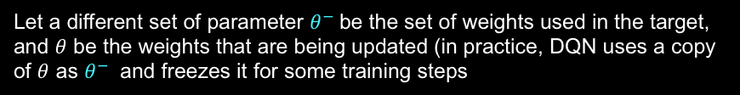

Deep Q-Learning
Use network to approximate $Q^{π}\left(s,a\right)$
Two challenges:
correlation between samples
non-stationary targets
Solutions of Deep Q-Network (DQN):
Experience Replay
Fixed Q targets
Let a different set of parameter $θ^{−}$be the set of weights used in the target, and $θ$ be the weights that are being updated (in practice, DQN uses a copy of $θ$ as $θ^{−}$ and freezes it for some training steps
Sample a batch from D for training
$$∇_{θ}J\left(θ\right)=\left(R_{t+1}+γ\max_{a}{\hat{Q}\left(s_{t+1},a,θ^{−}\right)}−\hat{Q}\left(s_{t},a_{t},θ\right)\right)∇_{θ}\hat{Q}\left(s_{t},a_{t},θ\right)$$
Replay memory D

Slide 39

Improved DQN
Double DQN
One problem of DQN: overestimate Q value
Use $\hat{Q}\left(s,a,θ^{−}\right)$ to both choose action and estimate the target
Vanilla DQN:
$$∇_{θ}J\left(θ\right)=\left(R_{t+1}+γ\max_{a}{\hat{Q}\left(s_{t+1},a,θ^{−}\right)}−\hat{Q}\left(s_{t},a_{t},θ\right)\right)∇_{θ}\hat{Q}\left(s_{t},a_{t},θ\right)$$
Double DQN:
Use two Q-network to choose action and estimate the target separately
No additional network need to be built (already have two network)
$$∇_{θ}J\left(θ\right)=\left(R_{t+1}+γ\hat{Q}(s_{t+1},\arg{\max_{a}{\hat{Q}(s_{t+1},a,θ)}},θ^{−})−\hat{Q}\left(s_{t},a_{t},θ\right)\right)∇_{θ}\hat{Q}\left(s_{t},a_{t},θ\right)$$

Slide 40

Improved DQN
Dueling DQN
Different network architecture, one head estimates the advantage function $A(s,a)$, another estimates $V(s)$
$Q\left(s,a\right)=A\left(s,a\right)+V(s)$
By decoupling the estimation, intuitively the Dueling DQN can learn which states are (or are not) valuable without having to learn the effect of each action at each state

Slide 41

Improved DQN
Prioritized Experience Replay
Idea: not every tuple is equally important
Experience with large difference between prediction and target should be paid more attention as larger difference means we have more can learn
Sampling weight for tuple $i$
$$p_{i}=|r+γ\max_{a′}{Q\left(s_{i+1},a^{′},θ^{−}\right)−Q(s_{i},a_{i},θ)}|$$

Slide 42
Lecture 5: Policy-based Reinforcement Learning

Slide 43
Policy-based RL
Now that our goal is to find an optimal policy, why not we just parameterize the policy as $π_{θ}(a|s)$
Compared with Value-based RL
Advantages:
better convergence properties
more efficient in high-dimensional or continuous action space
can learn stochastic policies, while value-based RL can not
Disadvantages:
usually converges to a local optimum
high variance when evaluating a policy (interact with the environment, not sampling enough episodes)

Slide 44

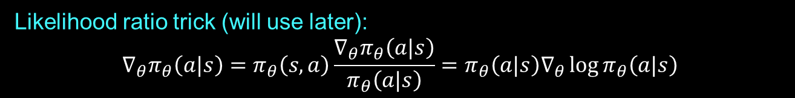


Policy Examples
Softmax Policy
Gaussian Policy
For discrete action space
For continuous action space
$$π_{θ}\left(a | s\right)=\frac{\exp{f_{θ}(s,a)}}{\sum_{a′}{\exp{f_{θ}(s,a^{′})}}}$$
mean is a function of state features $μ\left(s\right)=f_{θ}\left(s\right)$
variance may be fixed $σ^{2}$ or also be parameterized
$$a∼N(μ\left(s\right), σ^{2})$$
Likelihood ratio trick (will use later):
$$∇_{θ}π_{θ}\left(a|s\right)=π_{θ}\left(s,a\right)\frac{∇_{θ}π_{θ}\left(a|s\right)}{π_{θ}\left(a|s\right)}=π_{θ}\left(a|s\right)∇_{θ}\log{π_{θ}\left(a|s\right)}$$
score function

Slide 45

Policy Gradient for MDP
$τ$ is a trajectory sampled from the environment following policy $π_{θ}$
$$τ=\left(s_{0},a_{0},r_{1},…,s_{T−1},a_{T−1},r_{T},s_{T} \right)∼\left(π_{θ},P(s_{t+1 }|s_{t},a_{t})\right)$$
The policy objective is defined as
$J\left(θ\right)=E_{τ∼π_{θ}}\left[\sum_{t}{γ^{t}R(s_{t},a_{t})}\right]=\sum_{τ}{P\left(τ,θ\right)G(τ)}$ where $P\left(τ,θ\right)=μ(s_{0})\prod_{t=0}^{T−1}{π_{θ}\left(a_{t} | s_{t}\right)p(s_{t+1}|s_{t},a_{t})}$
The goal is
$$θ^{∗}=\arg{\max_{θ}{J\left(θ\right)}}$$
Take the gradient with respect to $θ$:
$$∇_{θ}J\left(θ\right)=∇_{θ}\sum_{τ}{P\left(τ,θ\right)G(τ)}=\sum_{τ}{∇_{θ}P\left(τ,θ\right)G(τ)}=\sum_{τ}{P\left(τ,θ\right)G\left(τ\right)∇_{θ}\log{P(τ,θ)}}$$
Approximate with empirical estimate of m sample trajectories:
$$∇_{θ}J\left(θ\right)≈\frac{1}{m}\sum_{i=1}^{m}{G(τ_{i})∇_{θ}\log{P(τ_{i},θ)}}$$
Likelihood ratio trick

Slide 46

Policy Gradient for MDP
Now we have
$$∇_{θ}J\left(θ\right)≈\frac{1}{m}\sum_{i=1}^{m}{G(τ_{i})∇_{θ}\log{P(τ_{i},θ)}}$$
Decompose $∇_{θ}\log{P(τ,θ)}$
$$∇_{θ}\log{P(τ,θ)}=∇_{θ}\log\left[μ(s_{0})\prod_{t=0}^{T−1}{π_{θ}\left(a_{t} | s_{t}\right)p(s_{t+1}|s_{t},a_{t})}\right]=\sum_{t=0}^{T−1}{∇_{θ}\log{π_{θ}(a_{t}|s_{t})}}$$
Thus
$$∇_{θ}J\left(θ\right)≈\frac{1}{m}\sum_{i=1}^{m}{G(τ_{i})\sum_{t=0}^{T−1}{∇_{θ}\log{π_{θ}(a_{t}^{i}|s_{t}^{i})}}}$$
We do not need to know the transition model !
Policy gradient is model-free

Slide 47

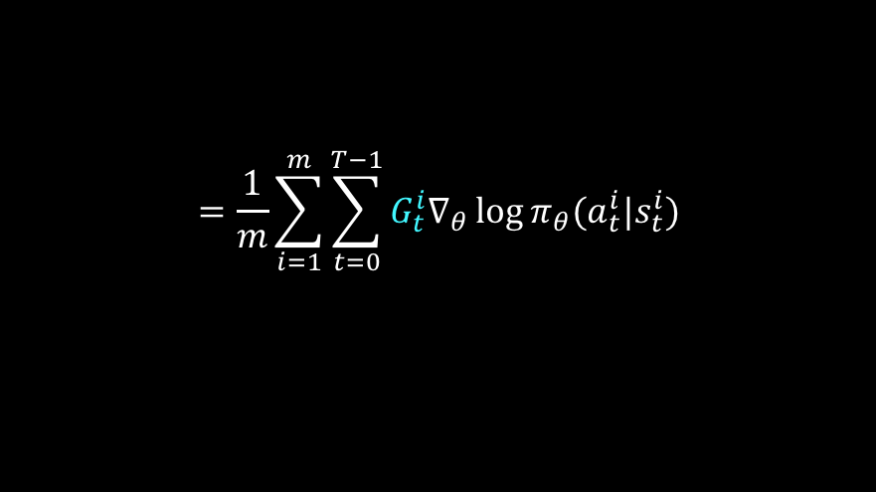
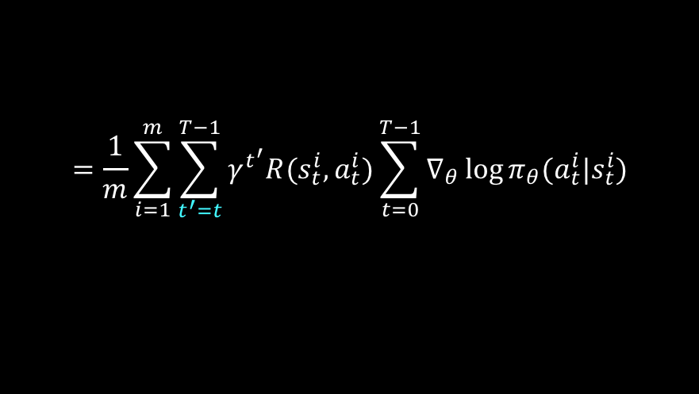

Problem of MC Policy Gradient
$$∇_{θ}J\left(θ\right)≈\frac{1}{m}\sum_{i=1}^{m}{G(τ_{i})\sum_{t=0}^{T−1}{∇_{θ}\log{π_{θ}(a_{t}^{i}|s_{t}^{i})}}}$$
Because $G\left(τ_{i}\right)=\sum_{t}{γ^{t}R(s_{t},a_{t})}$
unbiased but has large variance
ways to address the problem:
use temporal causality
include a baseline (talk about it later)
use critic (talk about it later)
Causality: policy at time $t′$ cannot affect reward at time $t$ when $t<t′$
$$∇_{θ}J\left(θ\right)≈\frac{1}{m}\sum_{i=1}^{m}{\sum_{t^{′}=0}^{T−1}{γ^{t^{′}}R(s_{t}^{i},a_{t}^{i})}\sum_{t=0}^{T−1}{∇_{θ}\log{π_{θ}(a_{t}^{i}|s_{t}^{i})}}}$$
$$=\frac{1}{m}\sum_{i=1}^{m}{\sum_{t^{′}=t}^{T−1}{γ^{t^{′}}R(s_{t}^{i},a_{t}^{i})}\sum_{t=0}^{T−1}{∇_{θ}\log{π_{θ}(a_{t}^{i}|s_{t}^{i})}}}$$
$$=\frac{1}{m}\sum_{i=1}^{m}{\sum_{t=0}^{T−1}{{G_{t}^{i}∇}_{θ}\log{π_{θ}(a_{t}^{i}|s_{t}^{i})}}}$$

Slide 48
REINFORCE

Slide 49


Include a Baseline
$$∇_{θ}J\left(θ\right)=E_{τ}\left[\sum_{t=0}^{T−1}{G_{t}}∇_{θ}\log{π_{θ}(a_{t}|s_{t})}\right]$$
We subtract a baseline $b(s)$ from the policy gradient to reduce variance
$$∇_{θ}J\left(θ\right)=E_{τ}\left[\sum_{t=0}^{T−1}{{\left(G_{t}−b(s_{t})\right)∇}_{θ}\log{π_{θ}(a_{t}|s_{t})}}\right]$$
A good baseline is the expected return
$$b\left(s_{t}\right)=E\left[R_{t}+γR_{t+1}+…+γ^{T−1−t}R_{T−1}\right]$$
We have
$$E_{τ}\left[∇_{θ}\log{π_{θ}\left(a_{t} | s_{t}\right)}b(s_{t})\right]=0$$
$$Var_{τ}\left[∇_{θ}\log{π_{θ}\left(a_{t} | s_{t}\right)}(G_{t}−b(s_{t}))\right]<Var_{τ}\left[∇_{θ}\log{π_{θ}\left(a_{t} | s_{t}\right)}G_{t}\right]$$

Slide 50
Vanilla Policy Gradient Algorithm with Baseline

Slide 51
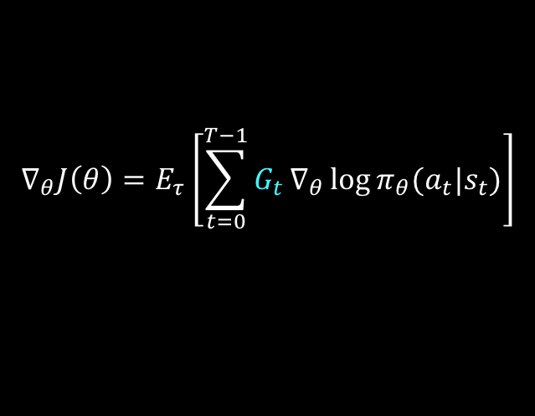
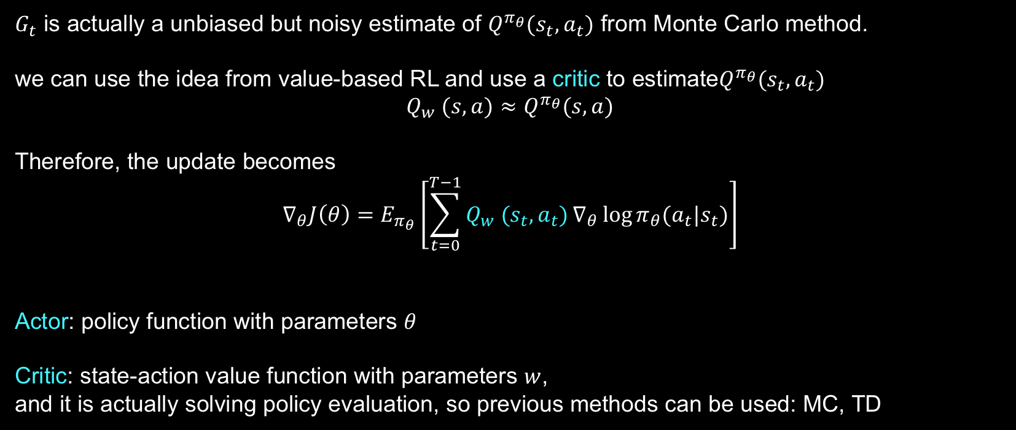
Using Critic to Reduce Variance
$$∇_{θ}J\left(θ\right)=E_{τ}\left[\sum_{t=0}^{T−1}{G_{t}}∇_{θ}\log{π_{θ}(a_{t}|s_{t})}\right]$$
$G_{t}$ is actually a unbiased but noisy estimate of $Q^{π_{θ}}(s_{t},a_{t})$ from Monte Carlo method.
we can use the idea from value-based RL and use a critic to estimate$Q^{π_{θ}}(s_{t},a_{t})$
$${Q_{w} (s,a)≈Q}^{π_{θ}}(s,a)$$
Therefore, the update becomes
$$∇_{θ}J\left(θ\right)=E_{π_{θ}}\left[\sum_{t=0}^{T−1}{Q_{w} (s_{t},a_{t})}∇_{θ}\log{π_{θ}(a_{t}|s_{t})}\right]$$
Actor: policy function with parameters $θ$
Critic: state-action value function with parameters $w$,
and it is actually solving policy evaluation, so previous methods can be used: MC, TD

Slide 52
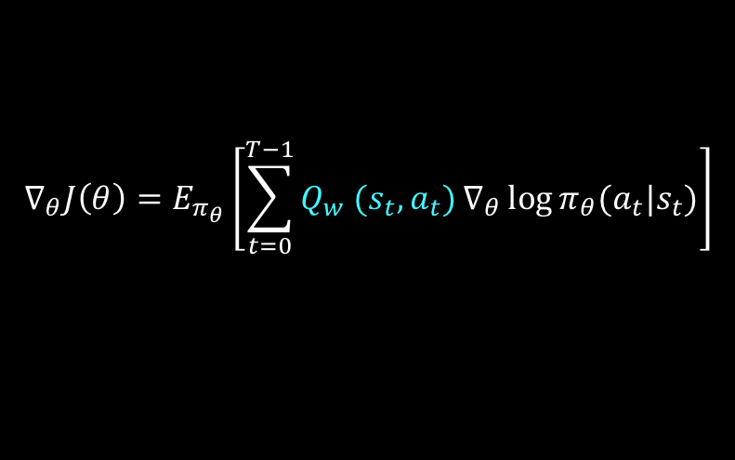
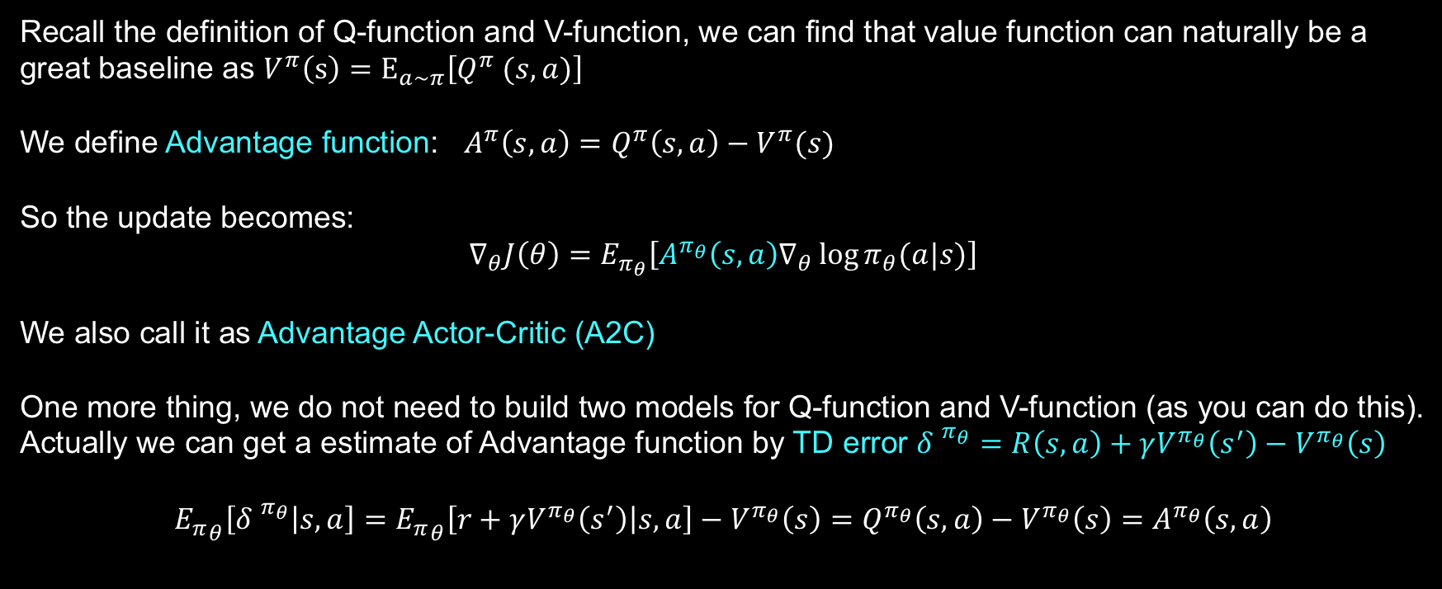
Actor-Critic with Baseline
$$∇_{θ}J\left(θ\right)=E_{π_{θ}}\left[\sum_{t=0}^{T−1}{Q_{w} (s_{t},a_{t})}∇_{θ}\log{π_{θ}(a_{t}|s_{t})}\right]$$
Recall the definition of Q-function and V-function, we can find that value function can naturally be a great baseline as $V^{π}\left(s\right)=E_{a∼π}\left[Q^{π} (s,a)\right]$
We define Advantage function: $A^{π}\left(s,a\right)=Q^{π}\left(s,a\right)−V^{π}(s)$
So the update becomes:
$$∇_{θ}J\left(θ\right)=E_{π_{θ}}\left[{A^{π_{θ}}\left(s,a\right)∇}_{θ}\log{π_{θ}(a|s)}\right]$$
We also call it as Advantage Actor-Critic (A2C)
One more thing, we do not need to build two models for Q-function and V-function (as you can do this).
Actually we can get a estimate of Advantage function by TD error ${δ^{ }}^{π_{θ}}=R\left(s,a\right)+γV^{π_{θ}}\left(s^{′}\right)−V^{π_{θ}}\left(s\right)$
$${E_{π}}_{θ}\left[{δ^{ }}^{π_{θ}} | s,a\right]={E_{π}}_{θ}\left[r+γV^{π_{θ}}\left(s^{′}\right) | s,a\right]−V^{π_{θ}}\left(s\right)=Q^{π_{θ}}\left(s,a\right)−V^{π_{θ}}\left(s\right)=A^{π_{θ}}\left(s,a\right)$$
omit the sum just for convenience
Just need one set of parameters to estimate V

Slide 53
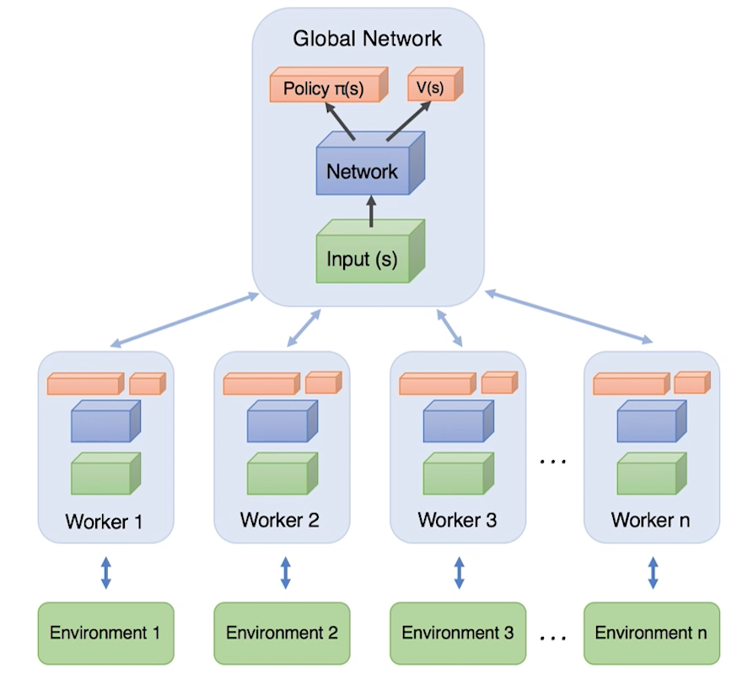
Asynchronous Advantage Actor-Critic
A3C system design:
Actor learners: multiple CPU threads on a single machine
Rely on parallel actors to explore different parts of the environment
Diversity of the agents make it no need for reply memory to stabilize the training
Send gradients back

Slide 54
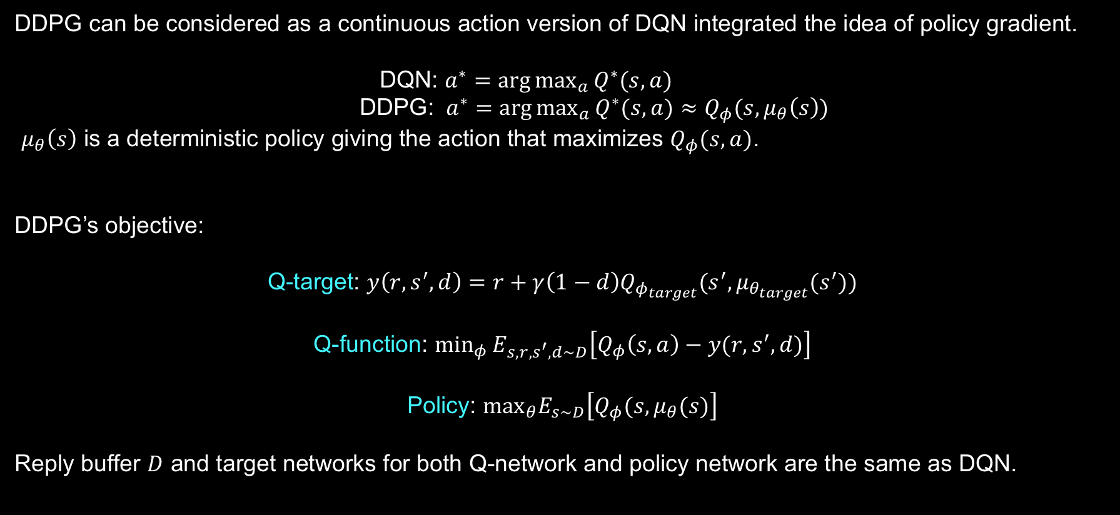
Deep Deterministic Policy Gradient
DDPG can be considered as a continuous action version of DQN integrated the idea of policy gradient.
DQN: $a^{∗}=\arg{\max_{a}{Q^{∗}(s,a)}}$
DDPG: $a^{∗}=\arg{\max_{a}{Q^{∗}(s,a)}≈Q_{φ}(s,μ_{θ}\left(s\right))}$
$μ_{θ}\left(s\right)$ is a deterministic policy giving the action that maximizes $Q_{φ}(s,a)$.
DDPG’s objective:
Q-target: $y\left(r,s^{′},d\right)=r+γ\left(1−d\right)Q_{φ_{target}}(s^{′},μ_{θ_{target}}(s^{′}))$
Q-function: $\min_{φ}{E_{s,r,s^{′},d∼D}\left[Q_{φ}\left(s,a\right)−y(r,s^{′},d)\right]}$
Policy: $\max_{θ}E_{s∼D}\left[Q_{φ}(s,μ_{θ}(s)\right]$
Reply buffer $D$ and target networks for both Q-network and policy network are the same as DQN.

Slide 55
Lecture 6: Model-based Reinforcement Learning

Slide 56
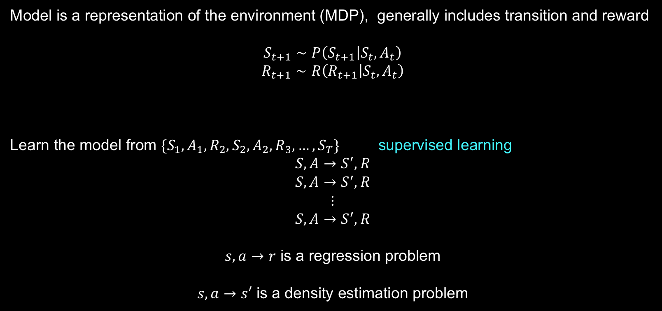
What is a Model
Model is a representation of the environment (MDP), generally includes transition and reward
$$S_{t+1}∼P\left(S_{t+1} | S_{t}, A_{t}\right)$$
$$R_{t+1}∼R\left(R_{t+1} | S_{t}, A_{t}\right)$$
Learn the model from $\{S_{1},A_{1},R_{2},S_{2},A_{2},R_{3},…,S_{T}\}$ supervised learning
$$S,A→S^{′},R$$
$$S,A→S^{′},R$$
$$⋮$$
$$S,A→S^{′},R$$
$s,a→r$ is a regression problem
$s,a→s′$ is a density estimation problem

Slide 57

Planning
If we have the model of the environment, we can do planning
experience $\underset{→}{learning}$ model $\underset{→}{planning}$ better policy
Dynamic programming is a kind of planning

Slide 58
Dyna
A structure that integrates learning, planning and reacting.
Based on different RL models( MC, Sarsa, Q-learning) ,
there are many types of Dyna.
Here is Dyna based on Q-learning.
two roles of real experience:
improve the value and policy
improve the model

Slide 59
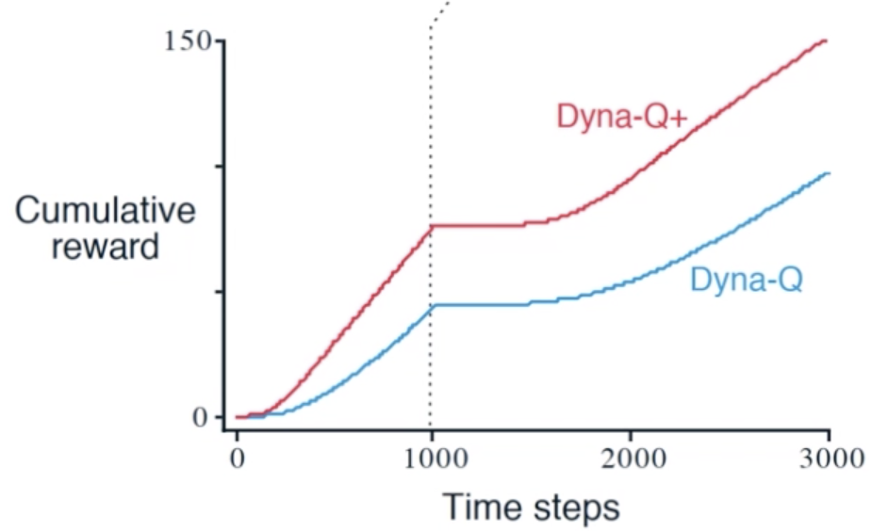
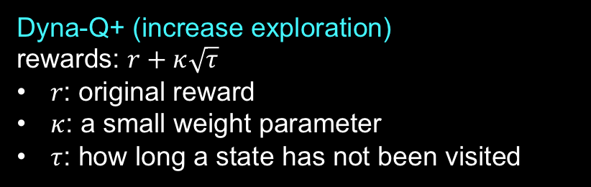
Result of Dyna
Dyna-Q+ (increase exploration)
rewards: $r+κ\sqrt{τ}$
$r$: original reward
$κ$: a small weight parameter
$τ$: how long a state has not been visited

Slide 60
Lecture 7: AlphaGo Zero

Slide 61
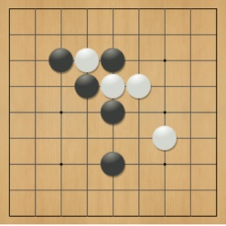
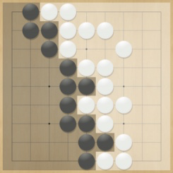
Rules of Go
Usually played on 19x19 board
Simple rules, complex strategy
Black and white place down stones alternately
Surrounded stones are captured and removed
The player with more territory wins the game

Slide 62
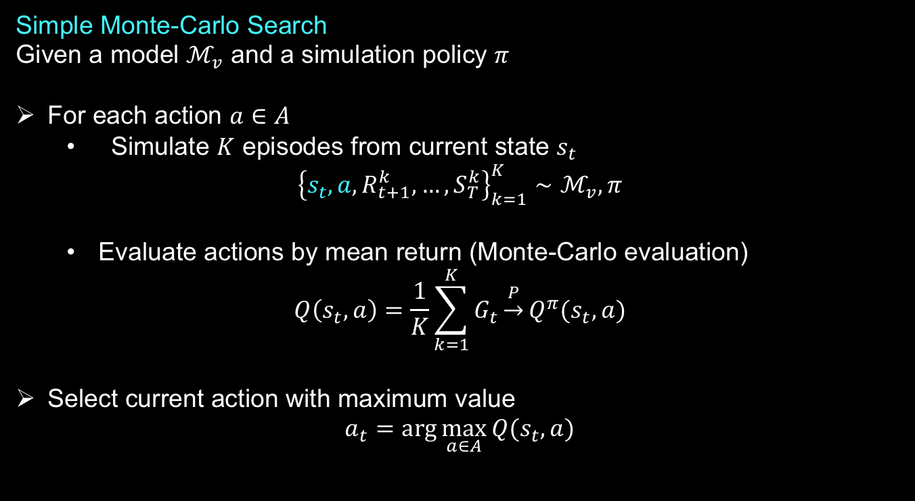
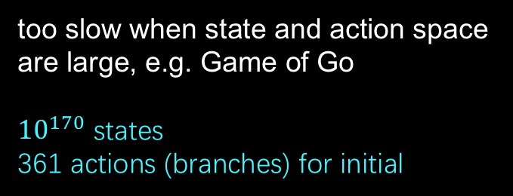
Simulation-based Search
Another type of methods that integrates model-based and model-free RL.
Simple Monte-Carlo Search
Given a model $ℳ_{v}$ and a simulation policy $π$
For each action $a∈A$
Simulate $K$ episodes from current state $s_{t}$
$${\left\{s_{t},a,R_{t+1}^{k},…,S_{T}^{k}\right\}}_{k=1}^{K}∼ℳ_{v},π$$
Evaluate actions by mean return (Monte-Carlo evaluation)
$$Q\left(s_{t},a\right)=\frac{1}{K}\sum_{k=1}^{K}{G_{t}}\underset{→}{P}Q^{π}(s_{t},a)$$
Select current action with maximum value
$$a_{t}=\arg{\max_{a∈A}{Q(s_{t},a)}}$$
too slow when state and action space are large, e.g. Game of Go
${10}^{170}$ states
361 actions (branches) for initial

Slide 63

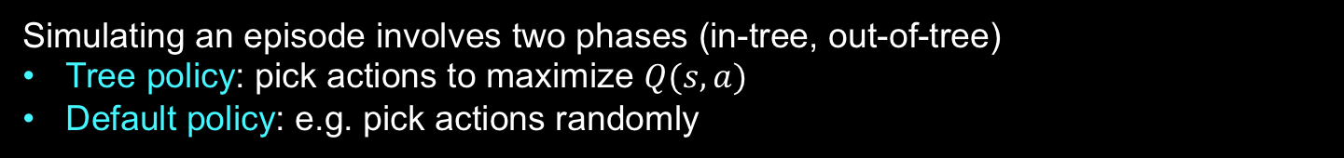
Simulation-based Search
Monte-Carlo Tree Search (MCTS)
Instead of simulating $K$ episodes for every action of current state, MCTS builds a search tree at the current state and just simulates $K$ episodes for current state.
Simulate $K$ episodes from current state $s_{t}$
$${\left\{s_{t},A_{t}^{k},R_{t+1}^{k},…,S_{T}^{k}\right\}}_{k=1}^{K}∼ℳ_{v},π$$
Evaluate actions by mean return (Monte-Carlo evaluation)
$$Q\left(s_{t},a\right)=\frac{1}{N(s_{t},a)}\sum_{k=1}^{K}{\sum_{u=t}^{T}{I\left(s_{uk}=s_{t},A_{uk}=a\right)G_{u}}}$$
Simulating an episode involves two phases (in-tree, out-of-tree)
Tree policy: pick actions to maximize $Q(s,a)$
Default policy: e.g. pick actions randomly

Slide 64
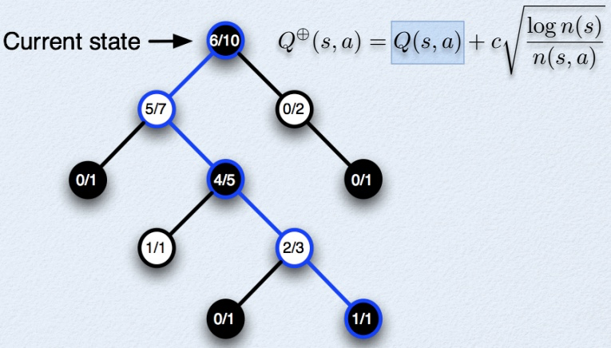


Simulation-based Search
Upper Confidence Tree (UCT) Search
Want to exploit the knowledge we have accumulated
Search the best nodes of the tree most deeply
Want to explore to accumulate more knowledge
Search the most uncertain nodes of the tree
Solution: use upper confidence bound on value
$$Q^{⨁}\left(s,a\right)=Q\left(s,a\right)+c\sqrt{\frac{\log{n(s)}}{n(s,a)}}$$
$n(s)$ is the simulation times of state $s$
$n(s,a)$ is the simulation times of state after taking action $a$
$c$ is a tuning parameter, larger $c$ means inspiring exploration
exploitation
exploration

Slide 65


Position Evaluation in Go
Reward function (undiscounted):
$R_{t}=0$ for all non-terminal steps $t<T$
$$R_{T}=\left\{\begin{aligned}1, if Black wins \\ 0, if White wins\end{aligned}\right.$$
Policy $π=\left\langle π_{B},π_{W}\right\rangle$ selects moves for both players
Value function (how good is position s):
$$v^{π}\left(s\right)=E_{π}\left[R_{T} | S=s\right]=P\left(Black wins | S=s\right)$$
$$v^{∗}\left(s\right)=\max_{π_{B}}{\min_{π_{W}}{v^{π}(s)}}$$

Slide 66





Monte-Carlo Tree Search in Go
(1)
(2)
(3)
(4)
(5)
Go is a 2 player game so tree is a minimax tree instead of expectimax tree
White minimizes future reward and Black maximizes future reward when computing action to simulate

Slide 67



AlphaGo Zero 模型基础
AlphaGo Zero 模型主要是两块：MCTS 和 Actor-Critic Network
对于神经网络，它的输入是当前的棋局状态，输出两部分，第一部分输出是在当前棋局状态下各个可能的落子动作对应的获胜概率 p，可以简单理解为 Actor-Critic 策略函数部分。另一部分输出为获胜或者失败的评估[-1, 1]，可以简单理解为 Actor-Critic 价值函数部分。
$$π$$
AlphaGo Zero 的行棋主要是由 MCTS 指导完成的，但是在 MCTS 搜索的过程中，由于有一些不在树中的状态需要仿真，做局面评估，因此需要一个简单的策略来帮助MCTS 评估改进策略，这个策略改进部分由神经网络完成。
$$π$$

Slide 68




AlphaGo Zero 训练过程简介
AlphaGo Zero 训练过程主要分为三个阶段：自我对战学习阶段，训练神经网络阶段和评估网络阶段。
自我对战
网络训练
网络评估
每一步的落子是由 MCTS 搜索来完成的。遇到不在树中的状态，则使用神经网络的结果来更新 MCTS 树结构上保存的内容。
在每一次迭代过程中，在每个棋局当前状态 $s$ 下，MCTS 给出最优的落子策略 $π$，这个策略 $π$ 和神经网络的输出 $p$是不一样的。当每一局对战结束后，我们可以得到最终的胜负奖励 $z$, 1或者-1.
收集样本$(s,π,z)$
训练的目的是对于每个输入 $s$, 神经网络输出的 $p, v$ 和训练样本中的 $π, z$ 差距尽可能的少
$$L={\left(z−v\right)}^{2}−π^{T}\log\left(p\right)+c{\left|\left|θ\right|\right|}^{2}$$
这个阶段主要用于确认神经网络的参数是否得到了优化，这个过程中，自我对战的双方各自使用自己的神经网络指导 MCTS 搜索，并对战若干局，检验AlphaGo Zero 在新神经网络参数下棋力是否得到了提高。除了神经网络的参数不同，这个过程和第一阶段的自我对战学习阶段过程是类似的。
$$π$$
$$π$$

Slide 69


AlphaGo Zero 的 MCTS
对于每个节点，记录以下信息
𝑁(𝑠,𝑎): 记录边的访问次数
𝑊(𝑠,𝑎): 合计行动价值 其中 𝑠 为当前棋局状态，𝑎 为某一落子选择对应的树分支。
𝑄(𝑠,𝑎): 平均行动价值
𝑃(𝑠,𝑎): 选择该条边的先验概率
对于 MCTS 内部，使用 UCT 选择子分支
$$U\left(s,a\right)=cP(s,a)\frac{\sqrt{\sum_{b}{N(s,b)}}}{1+N(s,a)}$$
$$a_{t}=\arg{\max_{a}{(Q\left(s,a\right)+U(s,a))}}$$
如果走到out-tree的情况，就需要扩展和仿真，对于叶结点 $s$，会利用神经网络对叶子节点做预测，得到当前叶子节点的各个可能的子节点位置 $s_{L}$ 落子的概率 𝑝 和对应的价值 𝑣, 对于这些可能的新节点我们在 MCTS 中创建出来，初始化其分支上保存的信息为
$$\{N\left(s_{L},a\right)=0, W\left(s_{L},a\right)=0, Q\left(s_{L},a\right)=0, P\left(s_{L},a\right)=P_{a}\}$$
回溯阶段，将新叶子节点分支的信息回溯累加到祖先节点分支上去。
这个 MCTS 搜索过程在一次真正行棋前，一般会进行约 1600 次搜索。
同时在随后的时间步中，这个MCTS搜索树将会继续使用，对应于实际所采取的行为的子节点将变成根节点，该子节点下的子树的统计数据将会被保留，而这棵树的其余部分将会丢弃 。

